Slide 1



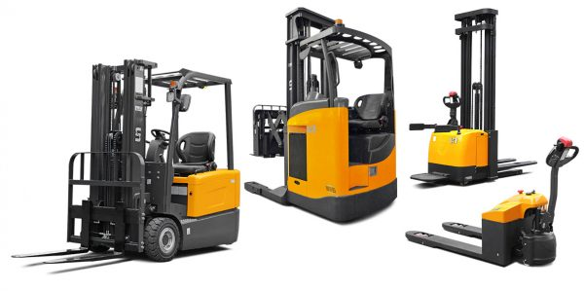



Energy savings using queueing theory models for the optimal number of Material Handling Equipment (MHE)
IEM – 5953
Date: 12/7/2019
Devarshi Tharwala (A 20159739)

Slide 2
Introduction
Material handling activities can be observed in almost all the industries and it accounts for 15-70% of the total production cost[1].
There have been many research conducted for the design of Material Handling Equipment (MHE)[2] and the selection of optimal MHE amongst ton of variety available in market[3].
Research about M/M/S Queueing model helps to determine the optimal number of forklift trucks required[4].
Optimizing number of material handling equipment can be calculated easily using M/M/S queuing model of operations research.
With that said, in real world industrial environment, to convince the management or the executive personnel, strong evidence is required to get approval to implement the warehouse operations with optimal number of material handling equipment calculated by queuing model.
This research shows how much energy can be saved and how much dollar savings can be achieved by implementation of queuing model in the real world of warehouse operations.
Keywords: Forklift trucks, M/M/S Queueing Model, Material Handling Equipment, Energy Savings, Optimization, Warehouse Operation

Slide 3
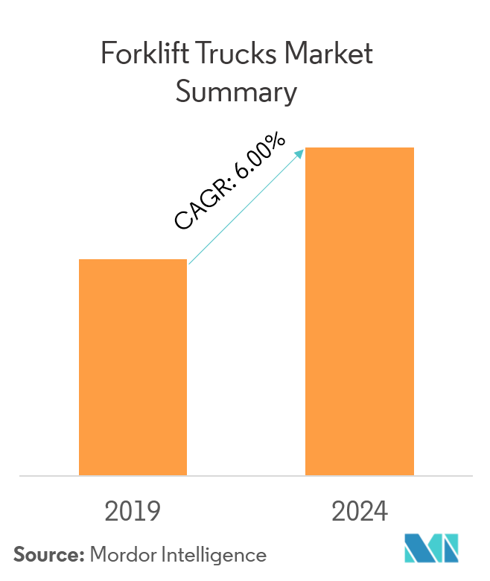
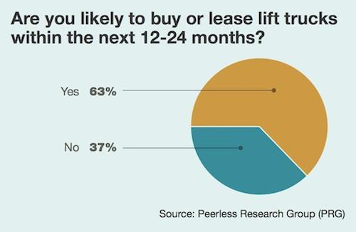
Importance
Forklift trucks is an integral part of the warehouse operation.
These trucks can lift loads and can efficiently move the material from one location to another. The forklift trucks thus does the work equivalent of twenty men[5].
Most of the industries are equipped with forklift trucks because of the advantages like better ergonomics, Flexibility in operation, better productivity.
According to the survey by Mordor Intelligence, the market of forklift trucks will increase by 6% CAGR by 2024[6].
CAGR: Compound Annual Growth Rate
Also, according to the survey by Peerless Research Group that there were 63% positive response when asked about the willingness to buy or lease the forklift trucks in 12-24 monts[7].
Thus, it becomes important that one should focus on this growing market and try to optimize the operation to benefit the industries related to the domain of forklift truck operation.

Slide 4
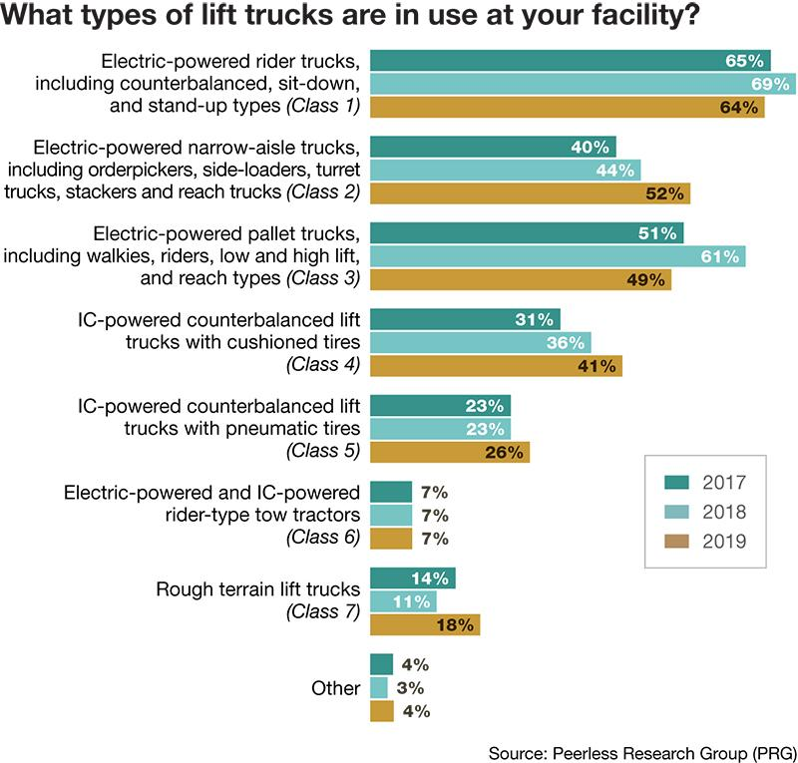
Types of Forklift Truck in used by different companies
The figure here shows the distribution of different types of forklift trucks used by different companies for last 3 years[8].
It can be observed that the most used forklift trucks are electric powered type.
Also, for most of the type of forklift trucks the growth rate is in the increasing order.
Thus, for the calculation point of view, electric powered forklift trucks are used to calculate the energy savings.

Slide 5
Methodology
Data Collection
Check for Optimized Operation
Calculate Optimized Number of Forklift Trucks
Provide Energy Savings
Figure shown here describes the methodology to calculate the energy savings on the basis of utilization factor

Slide 6
Data Collection
All the data for the given example are collected during the energy audit for Industrial Assessment Center (IAC) at Oklahoma State University.
The data is from the roofing solution company located in central Oklahoma, interviewed directly to the forklift truck operator and maintenance manager[9].
Data:
Electricity consumption cost…...................................................... $0.051/kWh
Electricity demand charge…......................................................... $11.52/kW
Number of forklift trucks currently in operation…........................ 24
Charging time of battery…............................................................ 9 hours
Finish Rate of Battery…............................................................... 39 Amps
Nominal Battery Voltage…........................................................... 48 Volts
Average Storage or Retrieval request for each forktruck truck…...8 / hour
Total Storage or Retrieval request ..................................................24 forklift truck*8 = 192 requests per hr
Frequency of charging a battery in a day…………………………2 times / day
Average Service time.................................................................... 4 min
Average Service rate.................................................................... 1 / 4 min

Slide 7
Checking for Optimized Operation
On the basis of queueing theory model the utilization rate can be calculated as[10]:
Utilization rate = (Total # of storage or retrieval requests) / [(# of forklift trucks) * (service rate)]
Here the units of total # of storage and retrieval requests and service rate should be same.
Thus, total # of storage and retrieval requests = 192 requests per hr / 60 mins = 3.2 requests per min.
Calculating Utilization rate:
Utilization rate = (Total # of storage or retrieval requests) / [(# of forklift trucks) * (service rate)]
Utilization rate = (3.2 requests per min) / [(24 forklift trucks) * (0.25 min)]
Utilization rate = 53%
The optimal utilization rate should be in between 70-80% for the warehouse management.
Here, the warehouse operations is underutilized and actually the operation need less forklift trucks than currently in operation.

Slide 8
Optimized Number of Forklift trucks
Next step is to calculate the optimal number of forklift trucks needed for the operation
Using the same formula of queueing model we can derive the equation for optimal number of forklift trucks required.
Calculation for optimal number of forklift trucks
Optimal Number of forklifts trucks = (Storage or Retrieval request) / (Optimal Utilization rate) (service rate)
Optimal Number of forklifts trucks = 3.2 / (0.70) (0.25)
Optimal Number of forklifts trucks = 18.2 ~ 18 forklift trucks
Here, 70% utilization rate is used for the calculation because now each fleet of material handling system has to do the same amount of work with less resources compared to before.
There will be always a resistance from the workers due to reduction in resource but the higher authority always should try to show them the positive aspects of the optimized operation.
The plan here is to gradually increase the utilization rate so make the transition smoother for the whole company.
Using this methodology the company may go higher in terms of utilization rate upto 80%.

Slide 9
Energy Savings Calculations
kW Demand required per battery charge
= (Amps per battery) (Battery Voltage) / (1000 Watts per kW)
= (39 Amps) (48 Volts) / (1000 W per kW)
= 1.87 kW
Annual Electricity kWh savings for 18 forklift trucks in service
= (kW of one time charging of battery) * (# hours required to charge battery) * (Reduced number of frequencies of charging in a day) * (# of operating days in a year)
= (1.87) *(9) *(12) *(260)
= 52,510 kWh
Annual kWh Dollar savings
= (Total Annual Electricity Savings) (Electricity cost)
= (52,510 kWh) * ($0.051 / kWh)
= $2,678

Slide 10
Demand Savings Calculations
Peak Demand Reduction for 18 forklift trucks in service per year
= (kW Demand per Battery) (number of forklift trucks removed from service) (number of months per year)
= (1.87 kW/ forklift truck) (6 forklift trucks) (12 months)
= 134.64 kW
Annual Demand Savings
= (Peak Demand Reduction per month) (12 months/year) (Demand charge)
= (134.64 kW) (12 months/year) ($11.52/kW)
= $18,613
Now, the total Annual Dollar Savings is the sum of Annual kWh savings and Annual Demand Savings
Annual Dollar savings
= (Annual kWh Dollar savings) + (Annual Demand Savings)
= ($2,678) + ($18,613)
= $21,291 / year

Slide 11
Implementation Rate and Payback Period
One of the benefit of increasing the utilization rate by reducing the number of forklift truck is that, there is no cost of implementation.
The company may definitely keep the rest of the fleets as a backup and during the breakdown there will not be any major circumstances into the warehouse operation.
If company wants they can even sell some of the fleets and can earn a significant amount of money from that. But this can only be practiced if company has enough fleets in operation and as well as a backup during some emergency.
As there is no implementation rate associated with this recommendation, the payback period is considered as immediate payback.

Slide 12
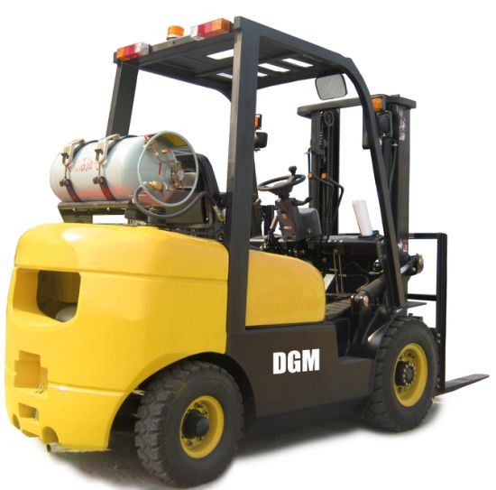
Propane Powered Forklift Trucks
Electric forklift truck are not the only type of forklift truck available in the market. There are many companies which preferes Propane powered forklift truck compare to electric battery driven forklift trucks due to their advantages.
The propane powered forklift trucks are good for outdoor applications they works perfectly fine in different kinds of terrain like snow, dirt or gravel[11].
It it convenient to change the propane cylinder and then ready to use the forklift truck and not to worry about charging like in battery powered fleets[12].
Figure 1.1 shows the propane powered forklift trucks.
Figure 1.1: Propane powered forklift trucks[13]

Slide 13
Energy Savings Calculation for Propane powered Forklift Trucks
The company for which energy savings was calculated earlier is also equipped with 6 propane powered forklift trucks.
Standard 33 lb propane tanks are mounted on the forklift trucks for the operation.
Cost per MMBtu obtained during the energy assessment for the company is $17.19/MMBtu of propane.
Now, converting the total annual kWh energy savings into MMBtu
Total annual MMBtu savings = total annual kWh savings * 0.003412 MMBtu/kWh
Total annual MMBtu savings = 52,510 kWh * 0.003412 MMBtu/kWh[14]
Total annual MMBtu savings = 179.17 MMBtu / year
Annual MMBtu Dollar savings
= (Total Annual Electricity Savings) (MMBtu cost)
= (179.17 MMBtu / year) * ($17.19/MMBtu)
= $3,080/year.
Thus on the basis of application and requirements company can either reduce the electric battery powered forklift trucks to save $2,678 per year or by reducing propane powered forklift trucks to save $3,080/year.

Slide 14
Scenario when Utilization factor is above 80%
For better operating life cycle of the forklift trucks, maintenance schedule is must.
It is recommended to have a full service after 200 hours of operation and full hydraulic system checkup after 600 hours of operation[15].
Due to extensive operation of forklift trucks, it result in accelatte the optimal time to replace the forklift truck, thereby reducing the lifespan of the equipment[16].
The following calculation shows the optimal number of forklift trucks requires for one of the ice cream manufacturing industries in Oklahoma during the energy audit of IAC.
Utilization rate of forklift truck at present
= (Storage or Retrieval request (min)) / (# of forklift trucks) * (service rate)
= (3.6) / (12) *(1/3) = 90%
Optimal Number of forklifts trucks
= (Storage or Retrieval request (min)) / (Optimal Utilization rate) (service rate)
= 3.6 / (0.75) (1/3) = 14.4 ~ 15 forklift trucks
Thus, currently the company is highly likely to spend more money in terms of maintenance cost and also reducing the life span of the forklift truck and thereby arising the need to buy new equipment earlier.

Slide 15
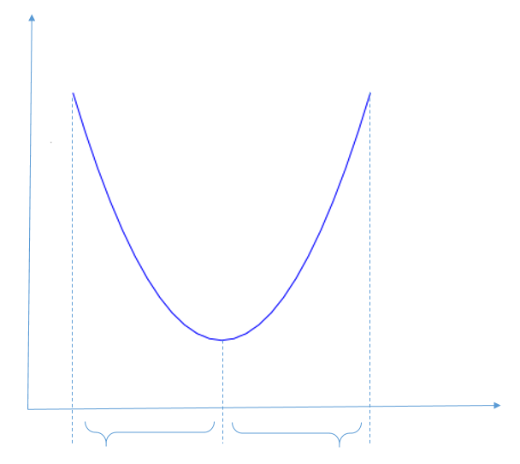
Summary
Total cost
From the earlier calculation it can be observed that the company is likely to spend more money if the operation is not optimized
Figure shows the approximate idea about the total cost vs the utilization factor.
The company operating at either side of the curve is willing to spend more.
Also, in real life scenario there is constant change in demand and accordingly the production plan is changed.
Due to this variable nature of the market, the company must check for the optimal utilization factor on regular basis.
Utilization factor
High utilization factor
Optimal utilization factor
Low utilization factor

Slide 16
Conclusion
Future Research
Thus, the theory explained earlier can be easily implement into the company relaying highly on material handling equipments.
The methodology is versitylein the sense that it can be applied to any type of material handling equipments like electric forklift trucks, propane forklift trucks, trolleys, hand carts, AGVs etc.
Furthermore, though most of the industries experienced high cost due to lower utilization factor, the very high utilization factor is also equally contributing toward higher operating costs.
For future research there could be a study regarding what can be the optimal method of transition when the company is trying to make some changes in the number of material handling equipment in operation.
Moreover, research regarding what could be the optimal time cycle to look for energy savings opportunities using the described method can be achieved due to varying number of factors in the real world market scenerio.

Slide 17
References
1.Riedel, R., Facilities planning - 4th edition by J.A. Tompkins, J.A. White, Y.A. Bozer and J.M.A. Tanchoco. 2011. p. 7519-7520.
2.Chittratanawat, S., An integrated approach for facility layout, P/D location and material handling system design. International Journal of Production Research, 1999. 37(3): p. 683-706.
3.Onut, S., S.S. Kara, and S. Mert, Selecting the suitable material handling equipment in the presence of vagueness. The International Journal of Advanced Manufacturing Technology, 2009. 44(7-8): p. 818-828.
4.Thiriez, H., Introduction to operations research: F.S. HILLIER and G.J. LIEBERMAN Fourth Edition, Holden-Day, San Francisco, 1987, 900 pages. 1988. p. 351-352.
5. ; Available from: https://thejournal.mheda.org/2013/03/06/facts-about-forklifts/.
6. ; Available from: https://www.mordorintelligence.com/industry-reports/forklift-trucks-market.
7. ; Available from: https://www.mmh.com/article/lift_truck_user_survey_readers_report_steady_growth.
8. ; Available from: https://www.logisticsmgmt.com/article/2019_lift_truck_survey_improving_warehouse_efficiencies_optimizing_operatio.
9.manager, F.t.d.a.p.m., Forktruck lift data, in Industrial Assessment Center (IAC)-OSU, I.E.A. Team, Editor. 2019.
10. ; Available from: https://people.revoledu.com/kardi/tutorial/Queuing/MM1-Queuing-System.html.
11. ; Available from: https://www.nitco-lift.com/blog/diesel-propane-or-electric-forklift/.
12. ; Available from: https://www.tmhnc.com/blog/buy-propane-lp-forklift-versus-electric-forklift.
13. ; Available from: https://dexing-industry.en.made-in-china.com/product/NKcnYeaWJlpE/China-CE-Certified-Yellow-3-tons-LP-Propane-Lift-Truck-Forklift-Truck-For-Sale-with-Optional-Triple-Mast-Side-Shift-Solid-Tires-Fork-Positioner-Nissan-K25-engine.html.
14. ; Available from: https://www.inchcalculator.com/convert/kilowatt-hour-to-million-btu/.
15. ; Available from: https://blog.hodgecompany.com/how-often-should-a-forklift-be-serviced
16. ; Available from: https://www.aalhysterforklifts.com.au/index.php/about/blog-post/the_optimal_time_to_replace_your_forklift.

